Slide 1



Magic Tactil
Give to your game the visibility it deserve.

Slide 2
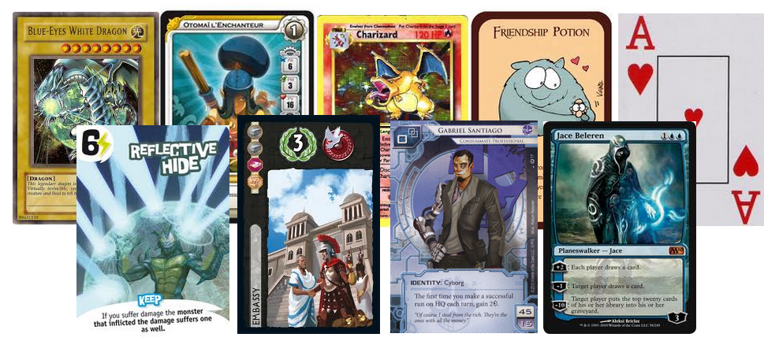
An adaptable platform for all table games.
Magic Tactil is an online platform adaptable to all card games and board games.

Slide 3
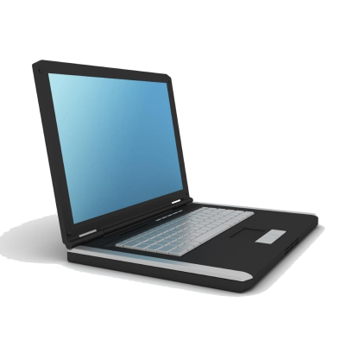
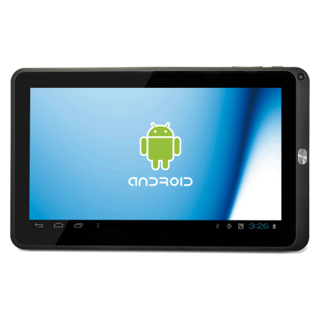
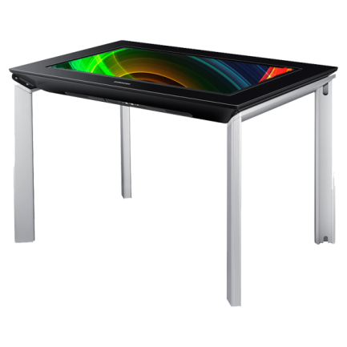
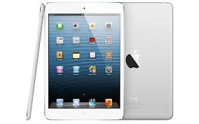
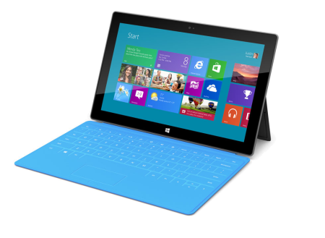
Your game compatible with several terminals.
PC (Windows 7, 8)
IPad
Tablettes Android
Surface
Table PixelSense

Slide 4






Numerous features.
Depending your game and your needs Magic Tactil may implement:
A friend management module
A tournament module
A collection module
A trade module
An event module
A shopping module

Slide 5
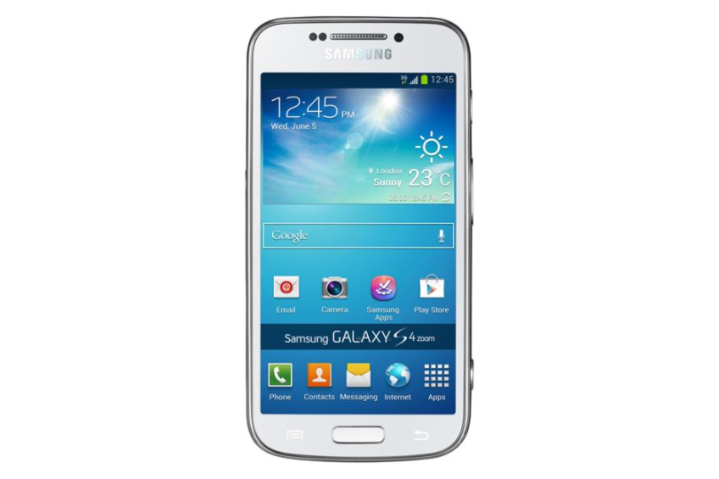
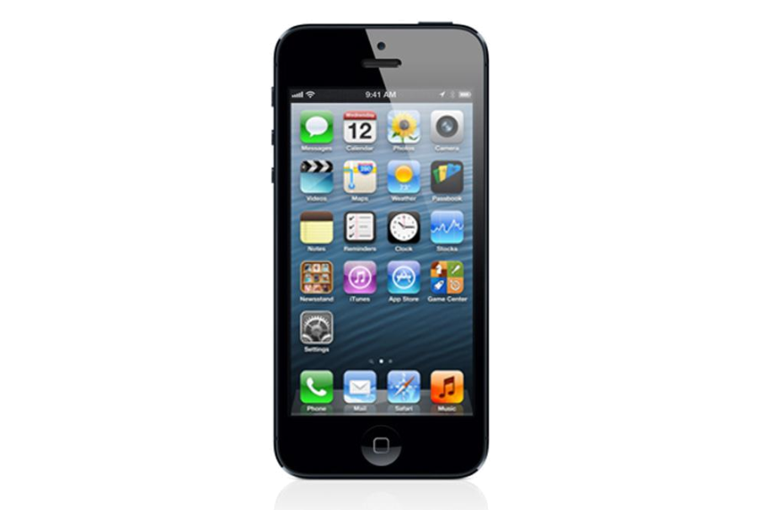
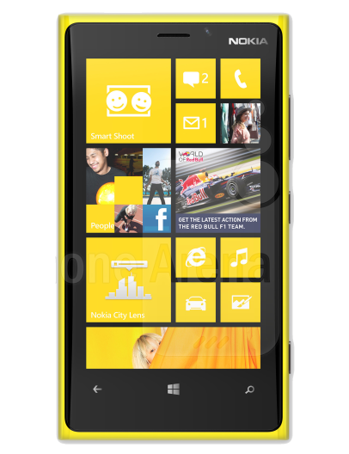
A community version for mobile terminals.
In addition to the PC and tablet versions, MagicTactil provides community applications for Smartphone. Users keep in contact with the game and their friends.
IOS
Android
Windows Phone

Slide 6

Your design, your universe.
We change the design of your applications
based on your game and your visual identity.

Slide 7
Get your applications in record time.
Your applications ready in 60 days.
The modules are ready, it only remains to inject your game and your design.
If you have special needs after version 1.0 we stay at your disposal to improve your applications.

